Slide 1
PCC Career Services Overview
Career Services:
Career Exploration Center and Jobs & Internships
Notes:
George 1-5

Slide 2
Agenda
Mission & Meet the Career Services Team
Career Development Process
Career Assessments
Resources for Occupational Research
Informational Interviews
Career Counseling & Decision Making
Cooperative Education / Internships
Job Search
Questions?
Notes:
George 1-5

Slide 3
Our Mission
To support students on their journey through the cycle of their career decisions, encouraging persistence and completion through their educational pathway, resulting in a position leading to a meaningful and purposefully chosen career.
Notes:
George 1-5

Slide 4
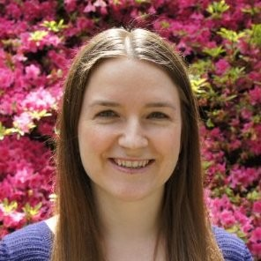
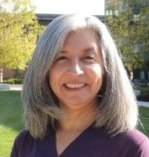
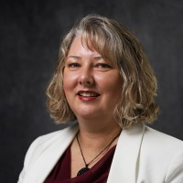
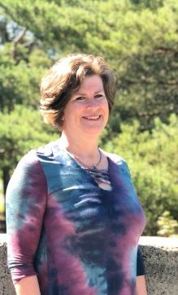
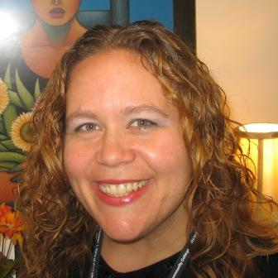
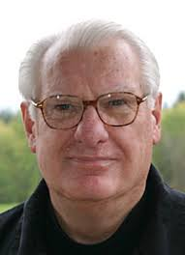
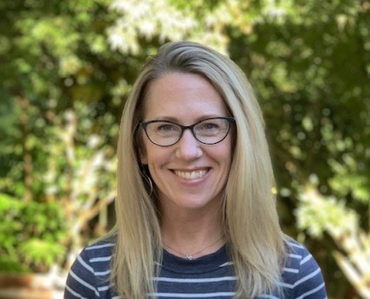
Meet Career Services Staff
https://www.pcc.edu/resources/careers/contacts.html
Cascade Campus
Southeast Campus
Tanya Maldonado, Career Services Coordinator
Jen Poinar
Career Services Coordinator
Rock Creek Campus
Sylvania Campus
Haydee Hernandez Goldenberg, Career Services Coordinator
Aimee Bosland Careers & Jobs Specialist
George Knox,
Jobs & Internships Coordinator
Diane Jantze
Jobs & Internships Specialist
Nicole Perez
Jobs &
Internship
Specialist
DeAnne Hardy Careers & Jobs Specialist
Bill Manley
Jobs & Internships Specialist
Rachel McMillen, Career Exploration Center Coordinator
Notes:
George 1-5

Slide 5
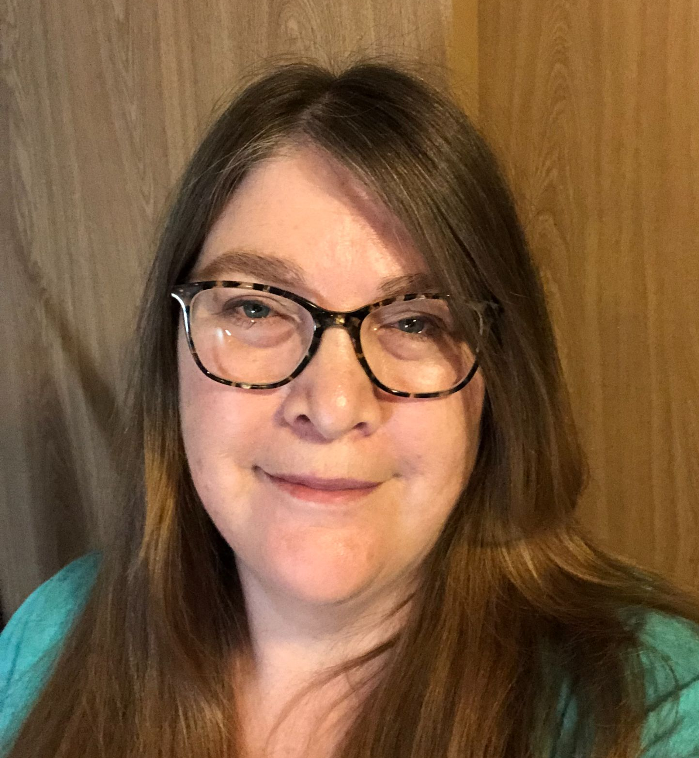
Career Services Admin Staff
Rock Creek Campus
Southeast Campus
Sylvania Campus
Pamela Fisher, Career Services Office Assistant II
Stefania Hardy
Career Services Administrative Assistant
Ruslana Rozhanskaya,
Jobs & Internships Office Assistant II
Cascade Campus
Shauna Smith
Career Services Office Assistant
Notes:
George 1-5

Slide 6
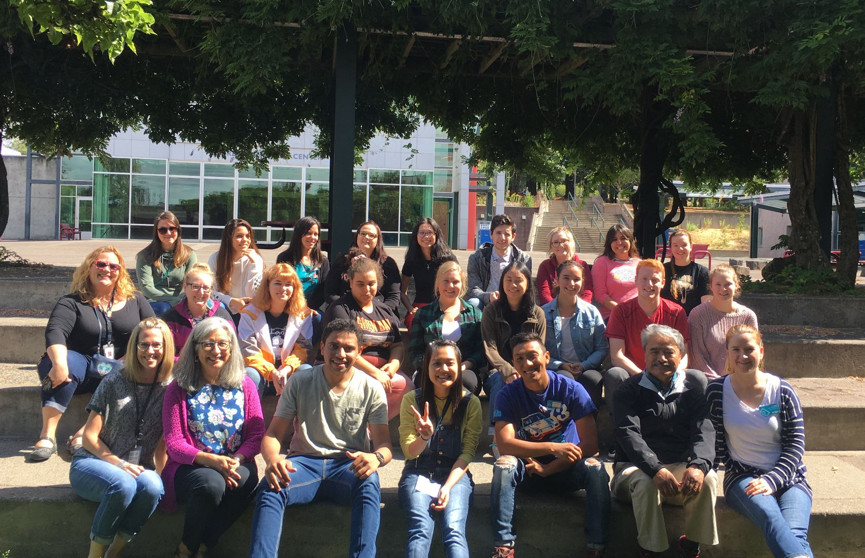
Peer Advisors
Peer Advisors | PCC
Notes:
Rachel 6-14

Slide 7
Up to 50% of first time college students were undecided at some point…
...and an estimated 75-85% of college students in the U.S. change their majors before graduation.
Notes:
Rachel 6-14

Slide 8
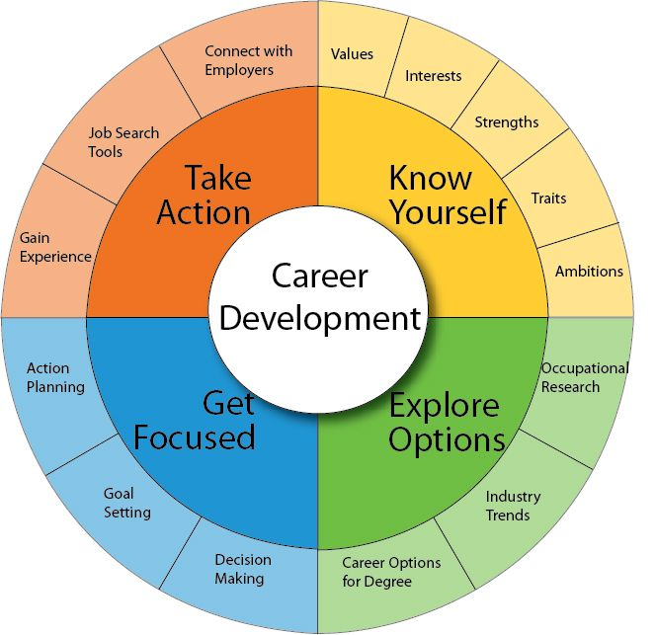
Steps to Choosing a Major or Career
Know Yourself: Career assessments
Explore Options: Research majors & occupations
Get Focused: Make decisions and set goals
Take Action: Get experience - try it out
Notes:
Rachel 6-14

Slide 9
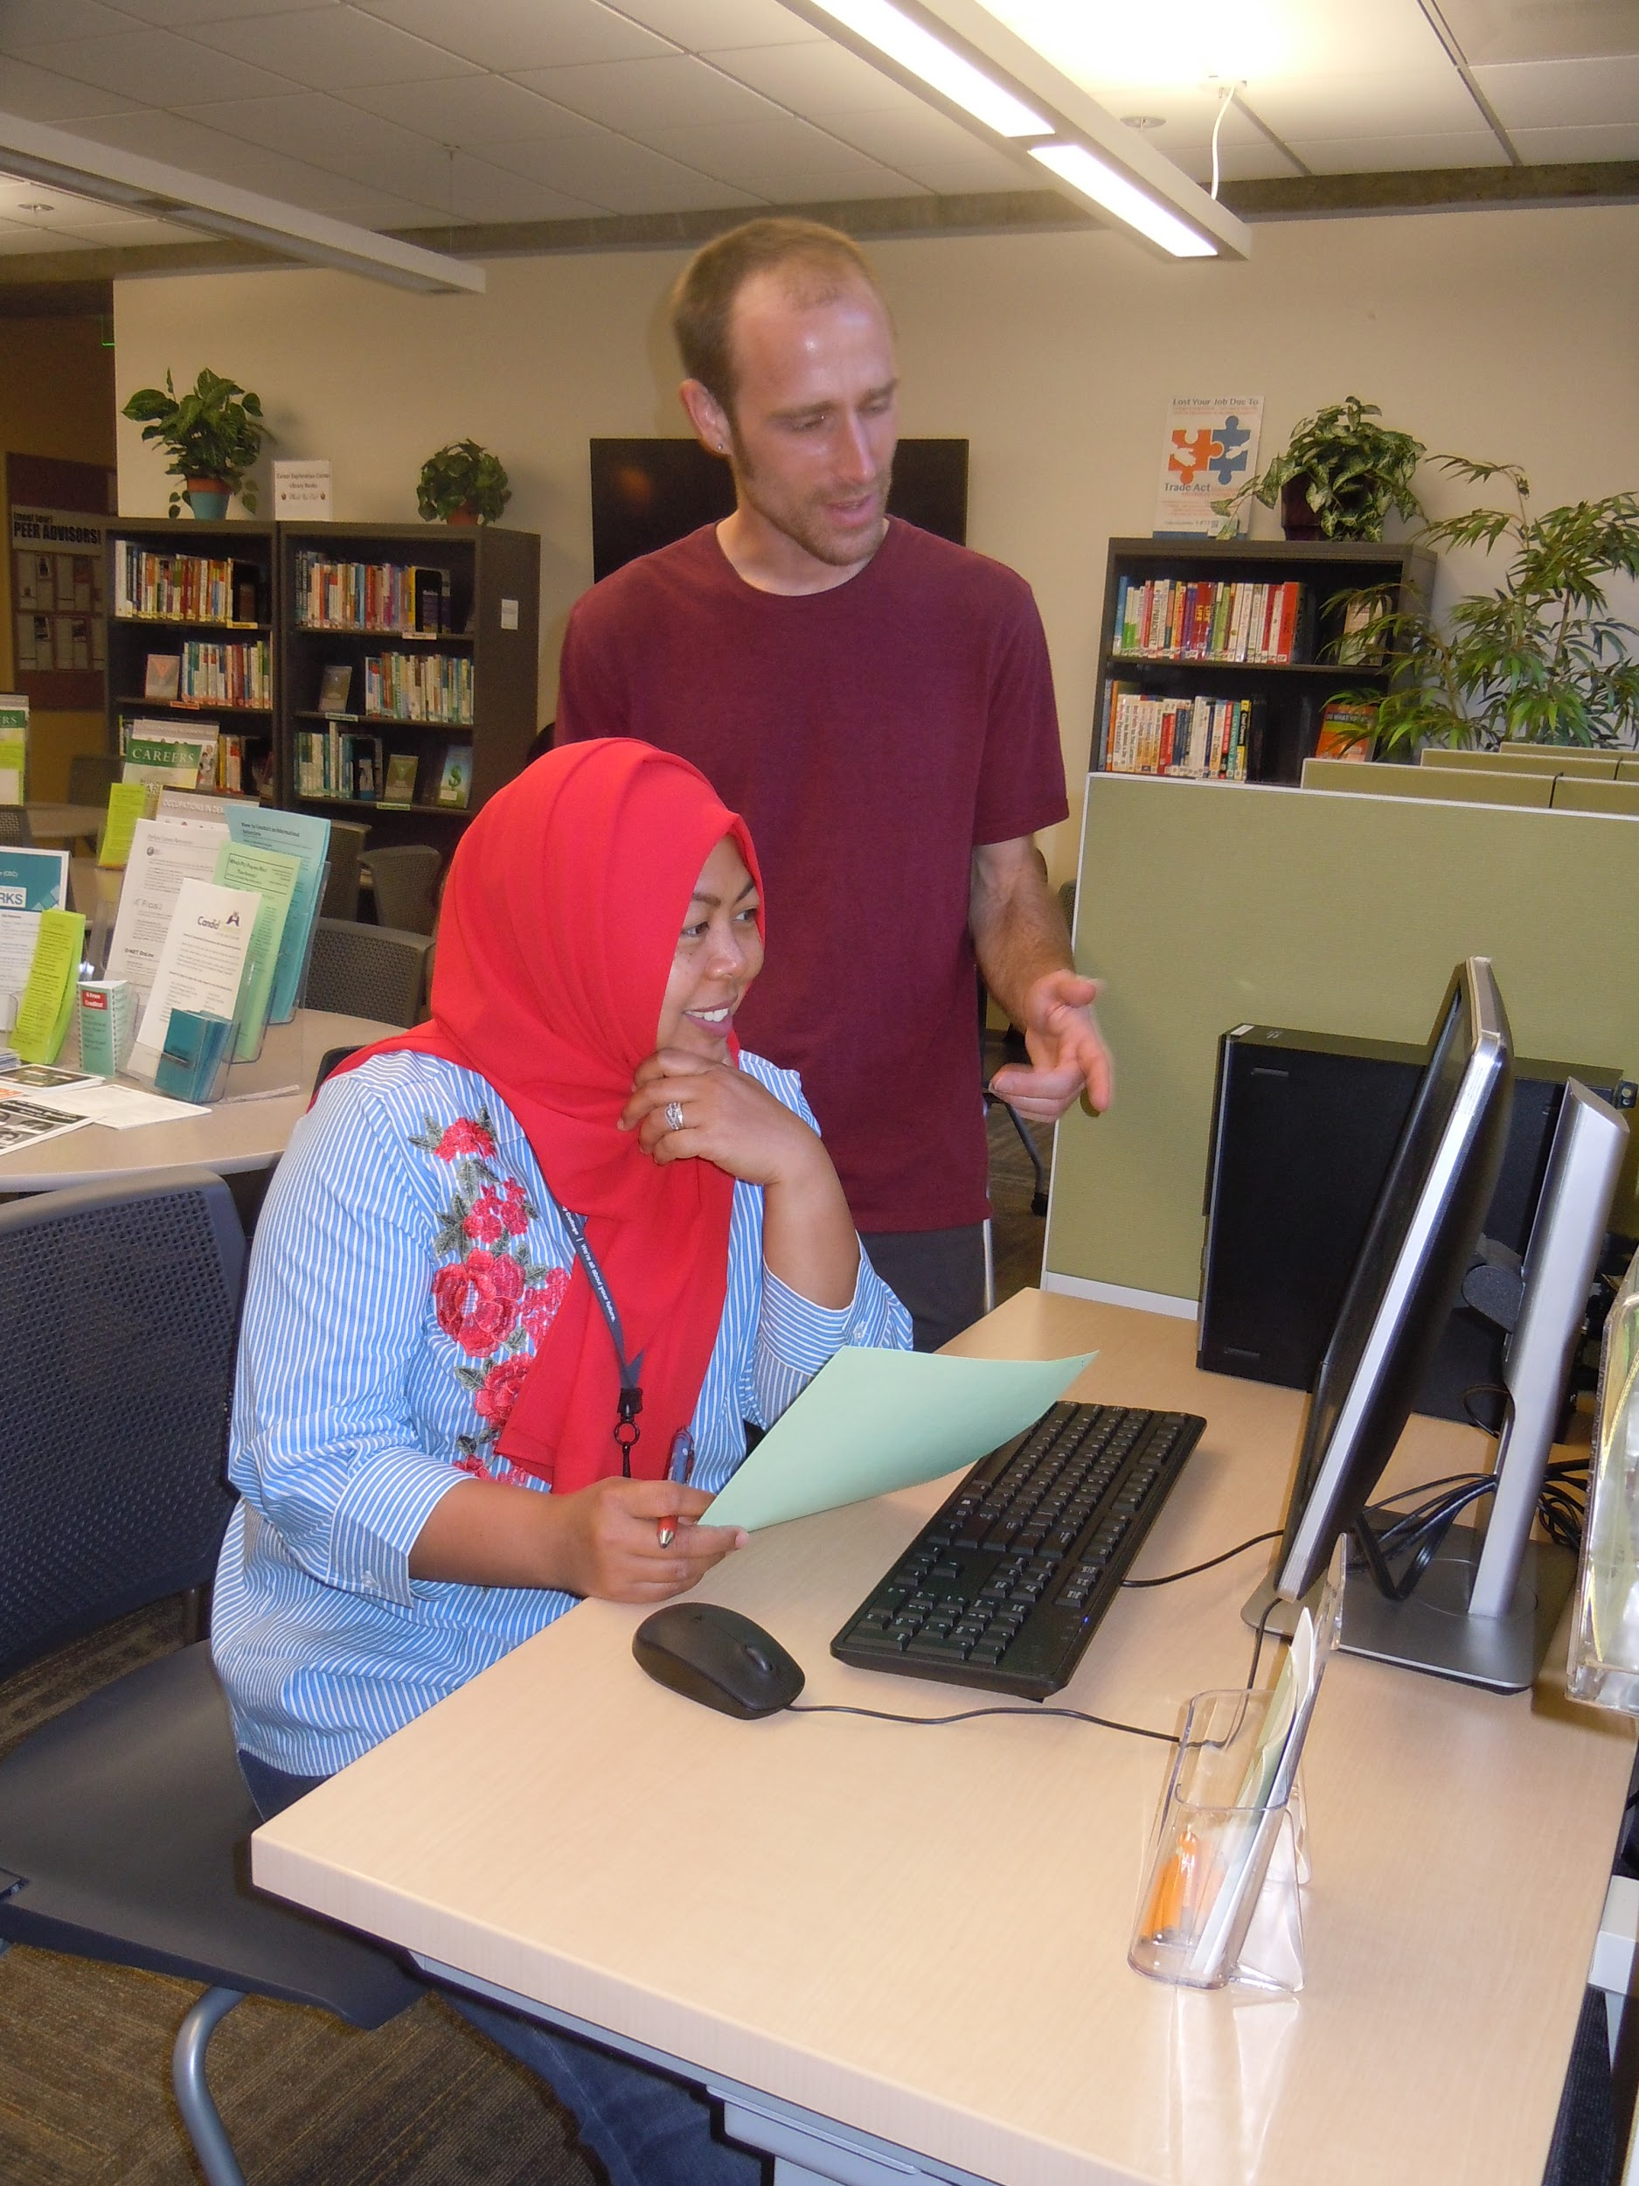
1 - Career Assessments
Oregon Career Information System (CIS) - Skills
Focus2 - Interests, Abilities, Personality & Values
Details on 500+ occupations
Notes:
Rachel 6-14

Slide 10
Log into your MyPCC & Select the “My Courses” tab
Oregon Career Information System (CIS)
Look for the “Plan my career” box on the right side of the screen

Slide 11
2 - Explore Options: Research Majors/Occupations
Use assessment results as a starting point
Both CIS & Focus2 have occupational databases
Watch career interviews with industry professionals
CandidCareer & Roadtrip Nation
Conduct your own informational interview
Find answers to, “What Can I Do with a Major in…?”
PDX.edu/careers and Focus2
Professional associations for information, scholarships & connections
Example: National Association of Social Workers (Careers - Career Center)
Notes:
Ask: what do you want to know about a major/career field before committing to it?
What the job entails, salary, job outlook, how much education, licensing, etc
*This slide takes time - briefly showing/sharing the various websites

Slide 12
Informational interviews:
Watch career interviews with industry professionals
https://roadtripnation.com/roadmap
Notes:
Rachel 6-14

Slide 13
Find answers to “What Can I Do with a Degree in…?”
Notes:
Rachel 6-14

Slide 14
Myths about Choosing a Major
Picking a major and career are the same thing.
The major I pick now will determine my lifelong career.
There’s just one major that’s right for me.
Notes:
Roughly only 27% of college graduates work in a field closely related to their major
It is estimated that most people will have 12 jobs during their lives.

Slide 15
3 - Get Focused: Make Decisions and Set Goals
Meet with Career Services staff or a PCC counselor for help narrowing down your options
Counseling contacts
Counselors provide both personal and career counseling and can help with:
Interpretation of self-assessment tools for interests, skills, values and personality type
Career decision-making
Educational goal setting to support career choice
Please note: you must be a registered student to access counseling resources at PCC
Notes:
Rachel 6-14

Slide 16
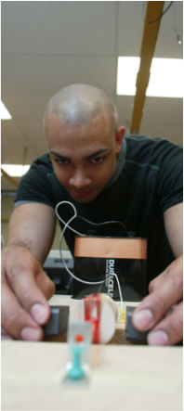
4. Get Experience / Try it Out / Learn at Work
Internships or Cooperative Education
Trainee/student positions applying what you learned from class in work settings and/or learning new skills and tools
May be paid/unpaid w/ scholarships, stipends
May be able to earn credit towards your degree/certificate
Career Services contacts
Volunteer Experience
Community-Based Learning
Volunteer Databases
Notes:
George 15-18

Slide 17
Jobs for Students & Graduates
Panther Works: PCC’s online job board for part-time and full-time jobs, via MyPCC on the Paying for College tab
Career Pathway Job Referrals: Career Services specialists work with students & graduates in career programs
Job Fairs & Other Recruiting: On-campus and virtual events open to PCC students (Panther Works, Careers Calendar)
Job Search Help: Individual assistance with resumes, letters, interviewing & job search strategies, Workshops/Webinars
Notes:
George 15-18

Slide 18
Log into your MyPCC & Select the “Paying for College” tab
NEED A JOB?
Look for this box on the right side of the screen

Slide 19
Next Steps
Career Services
Other PCC Resources:
Career & Life Planning Course (CG 140)
Today’s Careers Course (CG 130)
Counseling https://www.pcc.edu/counseling/
1 (Assessments)
2 (Research)
3. (Try it out)
Are you fairly open or have an idea but want to see what else is out there?
Do you have some ideas of majors or careers and need to learn more about them?
Do you know what major or field you’d like to pursue and you’re ready to try it out? Volunteer, Job Shadow, & Internships

Slide 20
Make an Appointment with Career Services
Meet with our staff to get help
with any of the steps in this process:
https://www.pcc.edu/careers/remote-services-request/
(More contact options on the Virtual Help Tab of MyPCC under Career Services)
Notes:
George 15-18

Slide 21
Notes:
George 15-18

